Slide 1

Stock Market Modeling
Rachael Songalewski, Jordan Cline, Christian Anderson, and Julian Rojas

Slide 2
Objective
We are looking to use past data from the S&P 500 to train a model that analyzes and estimates movement to predict the performance of individual company stocks

Slide 3
Useability of Machine Learning with Stocks

Slide 4

Machine Learning
What is the use of ML in stock prediction?
Just how big of an “ask” are we making of ML to crack this code?
What shortcomings exist with application of ML in stock prediction?
What is the major takeaway with all of this information?

Slide 5
Long Short Term Memory (LSTM)

Slide 6
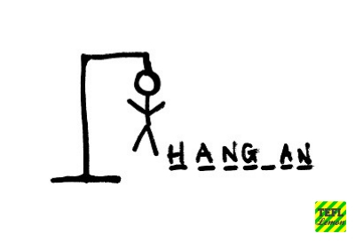
LSTM Explained
Long short-term memory (LSTM) is a kind of Neural Network known as a Recurrent Neural Networks

Slide 7

LSTM Explained (cont...)
RNNs have the long-term information traveling sequentially before getting to the current processing cell

Slide 8
The Model

Slide 9
Results

Slide 10
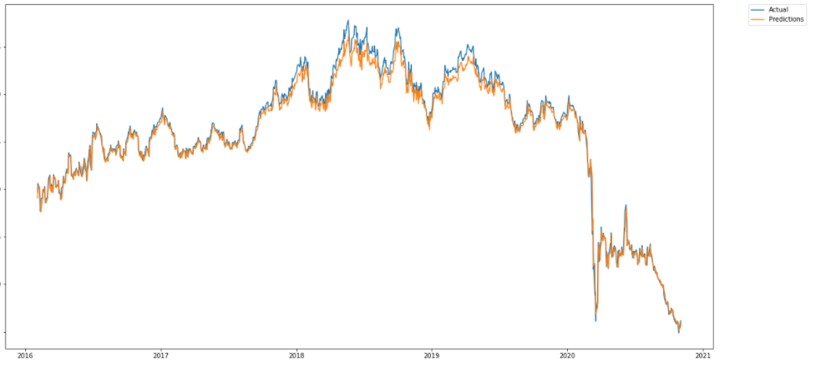
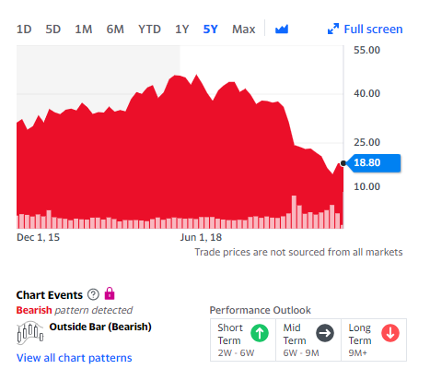
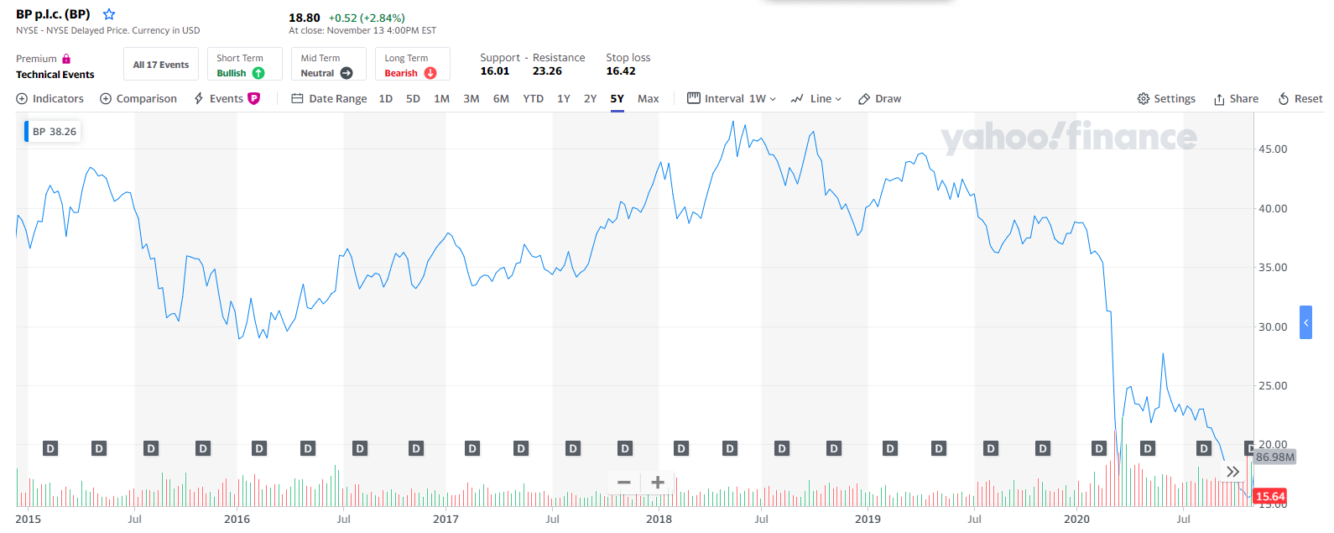
BP

Slide 11
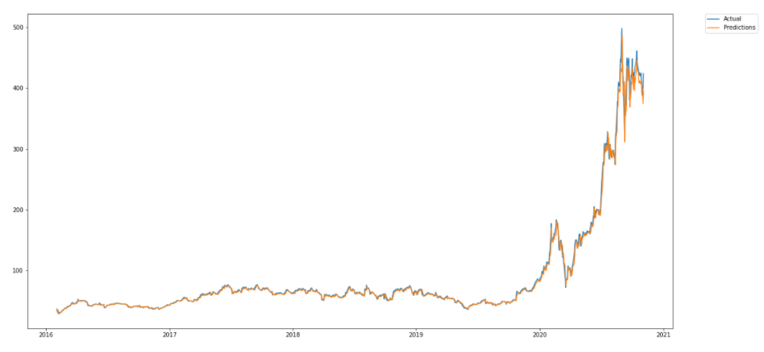
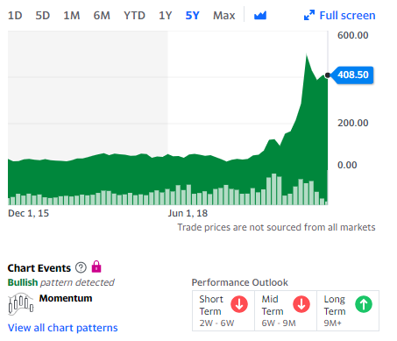
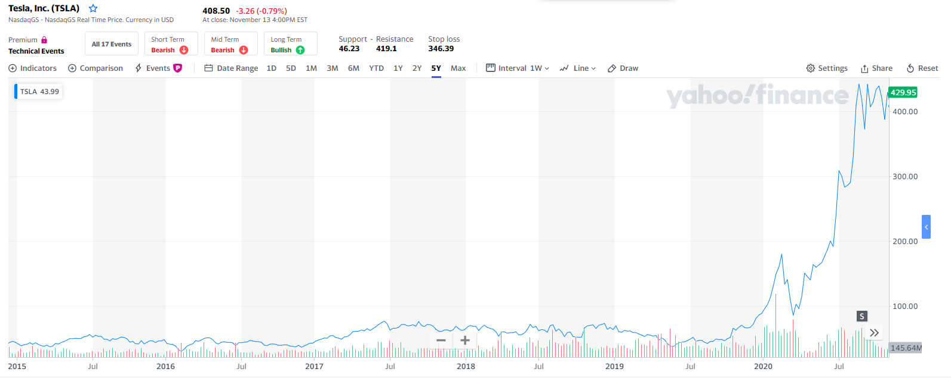
Tesla

Slide 12
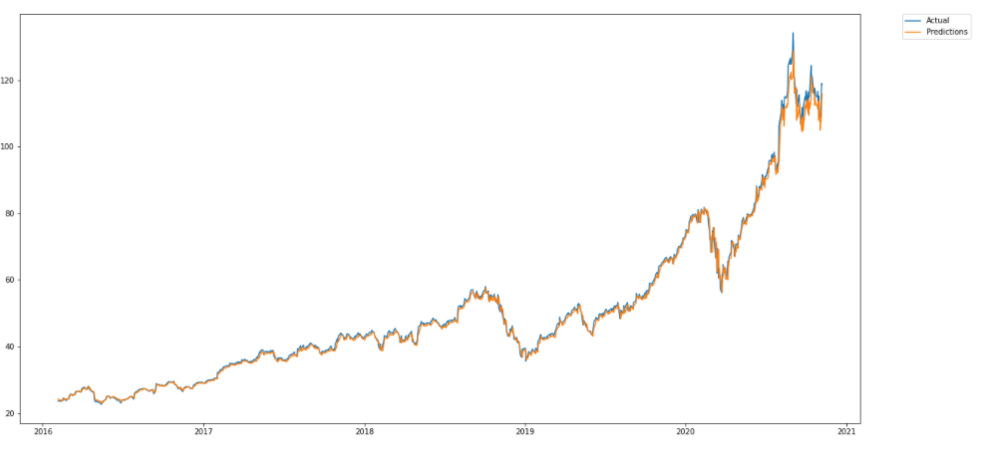
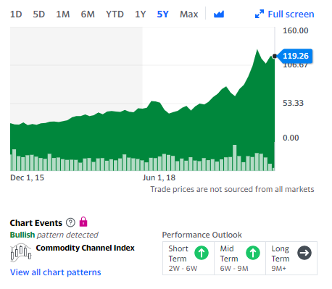
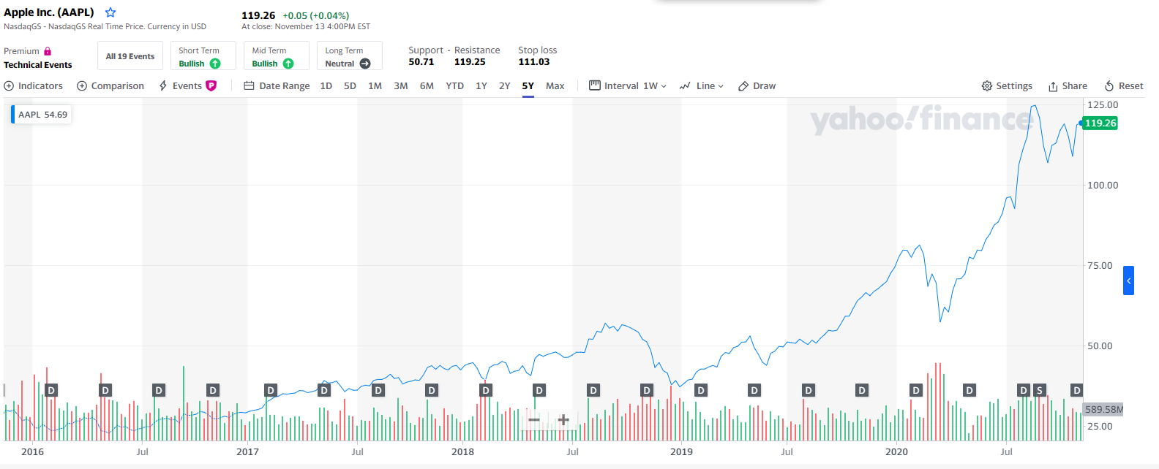
Apple

Slide 13
Questions?

